Slide 1
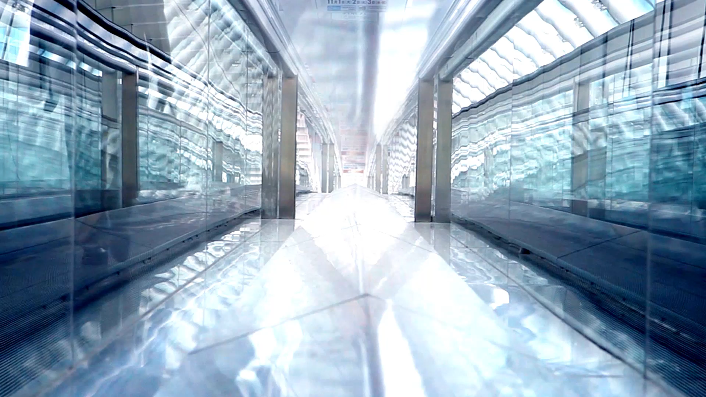
City of St. Petersburg Commercial Corridors: Investments and Property Value Analysis
ISM 6155 Group Project
BY - Aiswarya Reddy Rangam
Sai Sudhir Nayani
Arun Kumar Pathipati
Claudio Moncada
Caitlin Salerno

Slide 2

Introduction
The purpose of this study is to conduct a comprehensive analysis of non-school district taxable property values on commercial corridors in the CRA since 2018, with a focus on understanding annual changes and overall trends.
The study aims to provide insights into how the non-school district taxable property values across ALL commercial corridors have changed over time since 2018.
In addition, the study will develop a visualization that ranks the commercial corridors based on the percentage change in non-school district taxable values, providing a clear understanding of which corridors experienced the highest and lowest increases.

Slide 3
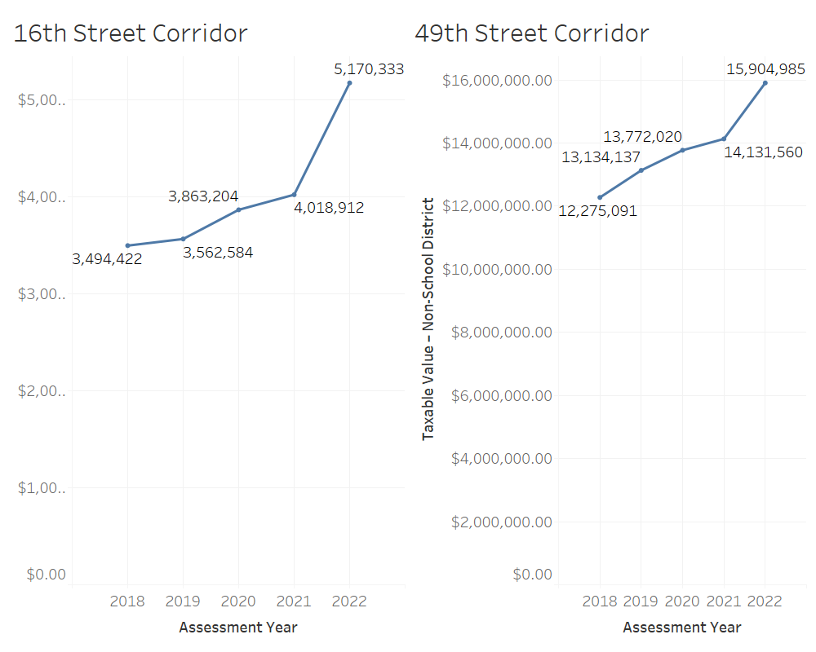
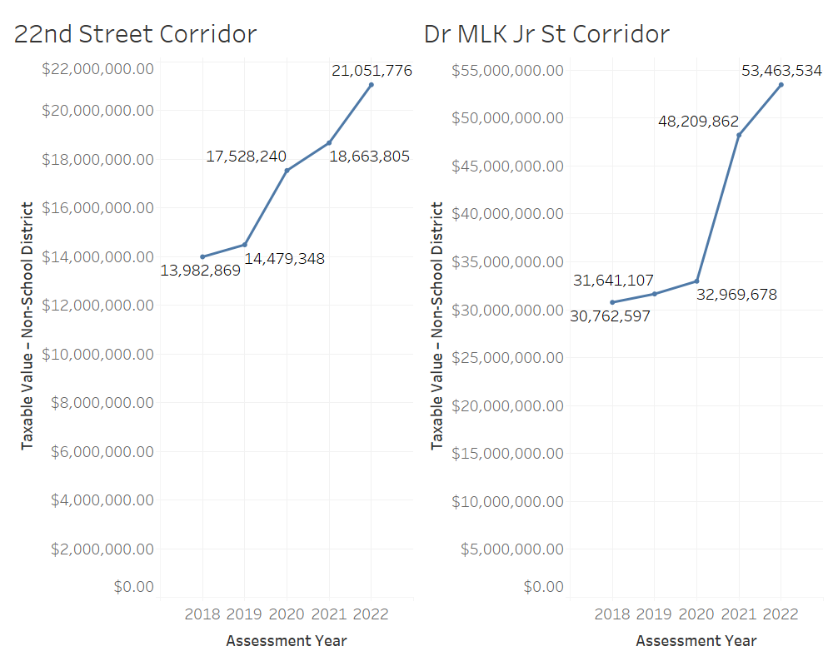
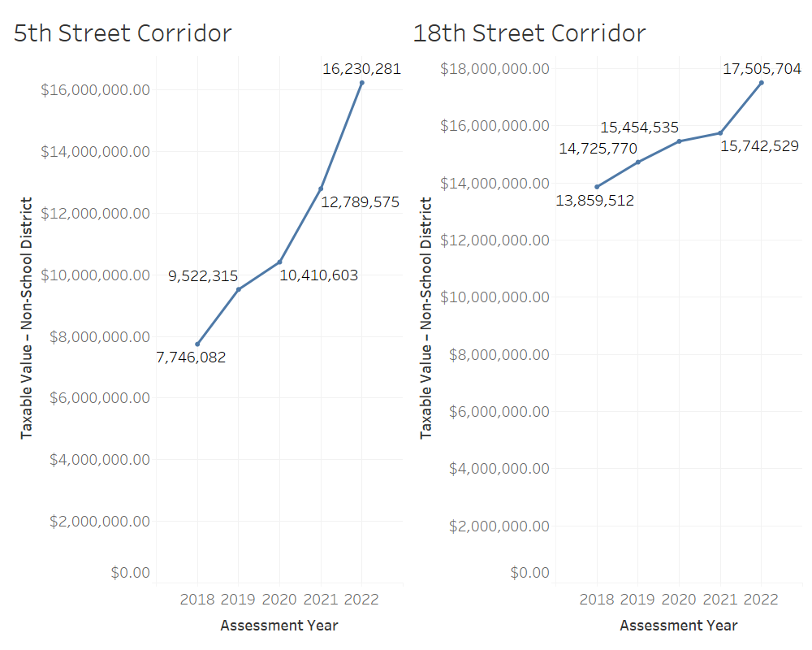
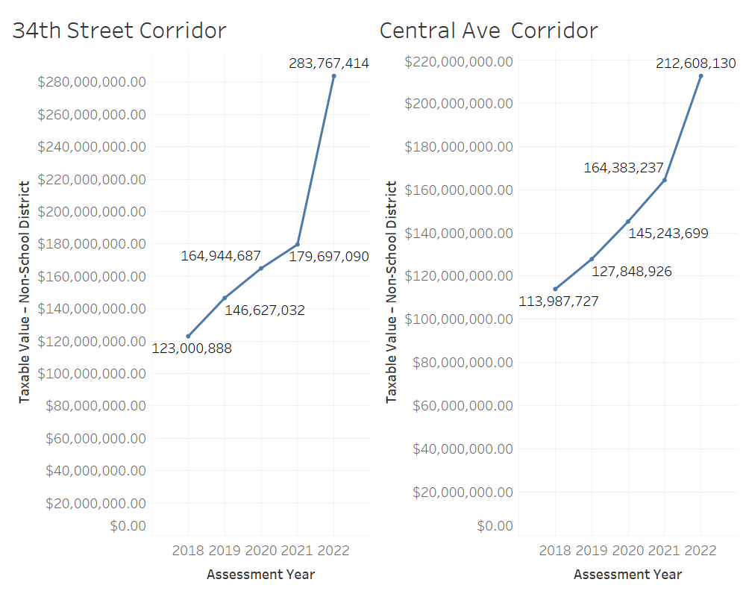
Annual Changes in Non-School District Taxable Property Values on Commercial Corridors Since 2018

Slide 4
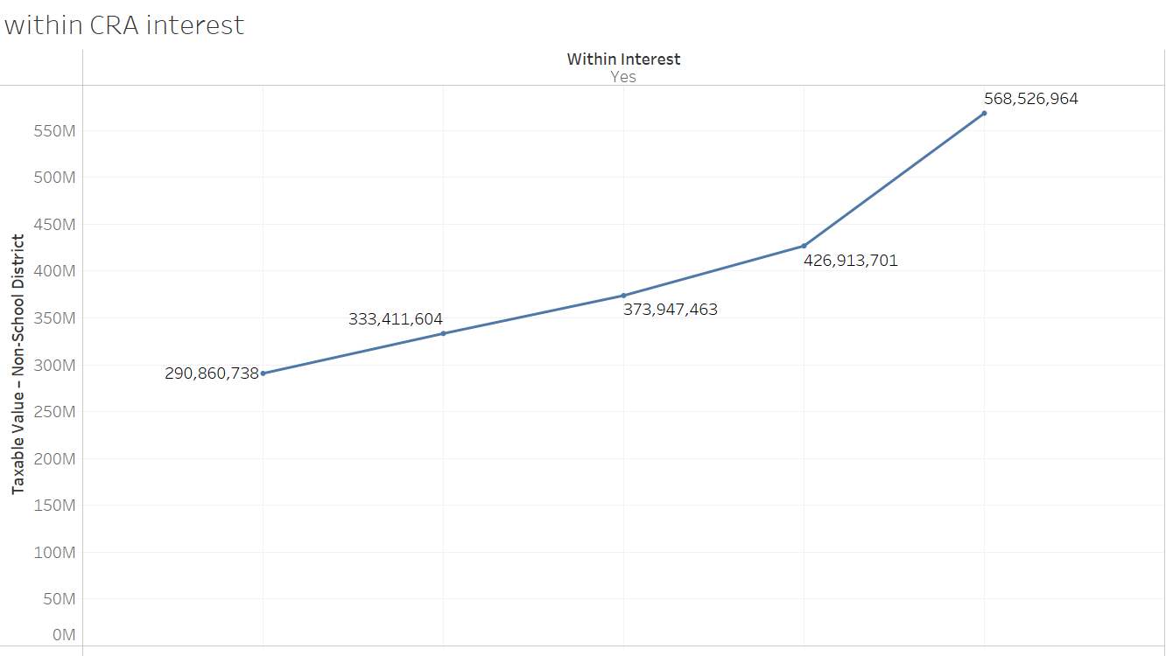
Annual Changes in Non-School District Taxable Property Values Across ALL Commercial Corridors in the CRA Since 2018

Slide 5
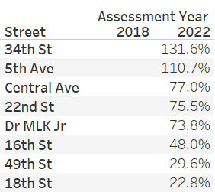
Ranking of Commercial Corridors by Percentage Change in Non-School District Taxable Property Values Since 2018

Slide 6

Importance of the Analysis for Stakeholders in the CRA and Its Contribution to the Existing Literature on Commercial Property Market Trends and Policy Implications
This analysis will provide crucial information for stakeholders in the CRA, such as policymakers, property owners, investors, and developers, to better understand the trends and dynamics in the commercial property market.
It will help them make informed decisions about future investments, development strategies, and policy interventions that support sustainable economic growth and community development.
The findings of this study will contribute to the existing literature on property value trends in commercial corridors and provide insights into the effectiveness of current policies and initiatives.

Slide 7
Conclusion
Based on the data analysis of changes in non-school district taxable values, the 34th Street Corridor and 5th Avenue are the top two corridors with over 100% change in revenue. This indicates that these corridors have the potential for significant growth and development. Therefore, we recommend that the CRA consider these two corridors for restructuring and updating infrastructure.
Additionally, we recommend that the Central Avenue, 22nd Street, and Dr MLK Jr corridors be considered for potential development opportunities, given their significant increases in revenue with over 70% change in the past four years. By focusing on these corridors, the CRA can help drive economic growth, increase property values, and enhance the overall quality of life for residents and visitors in the community.

Slide 8


